Slide 1

Introduction to OpenMP
Part4. Advanced Topics
人工智能技术学院
缪青海
miaoqh@ucas.ac.cn

Slide 2
Content
Getting started with OpenMP
Core features of OpenMP
Work with OpenMP
Advanced topics of OpenMP

Slide 3
Working with OpenMP
Tasks
Monte Carlo Calculations
The scary stuff
  Memory model
  Atomics
  Flush
  Pairwise Synchronization

Slide 4
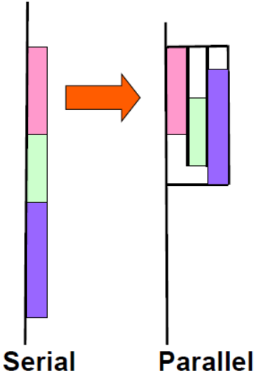
OpenMP Tasks
Tasks are independent units of work.
Tasks are composed of:
  – code to execute
  – data environment
  – internal control variables (ICV)
Threads perform the work of each task.
The runtime system decides when tasks are executed
  – Tasks may be deferred
  – Tasks may be executed immediately

Slide 5
Task Definitions
Task construct
  – task directive plus structured block
Task
  – the package of code and instructions for allocating data created when a thread encounters a task construct
Task region
  – the dynamic sequence of instructions produced by the execution of a task by a thread

Slide 6
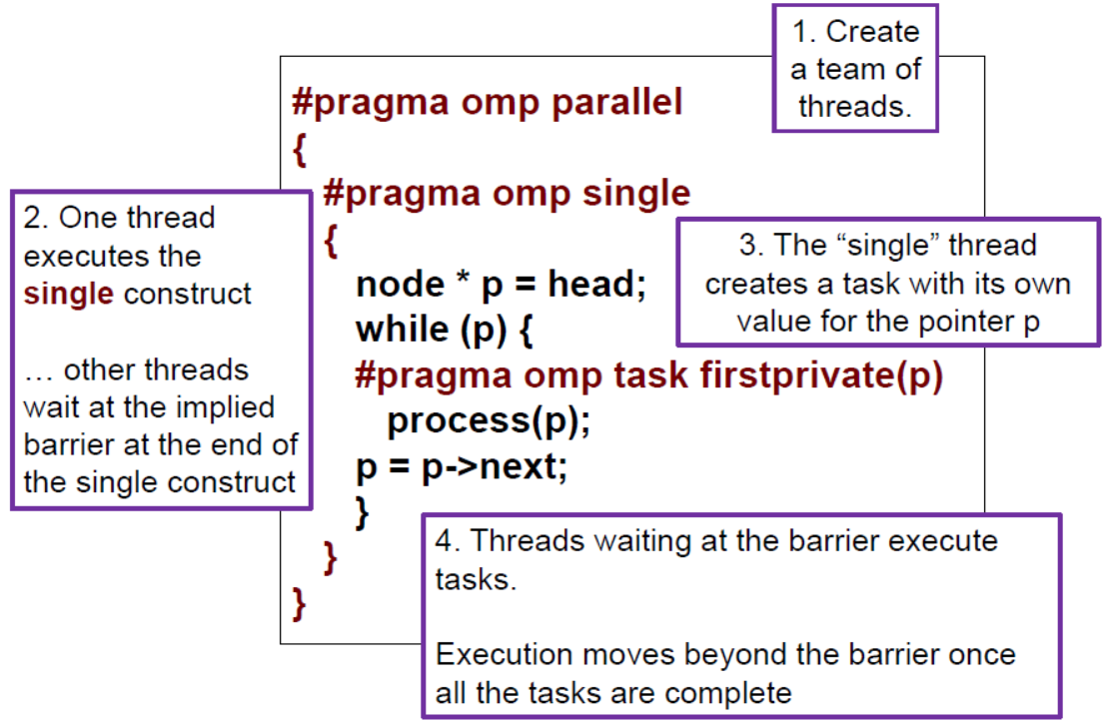
Task Construct – Explicit Tasks

Slide 7
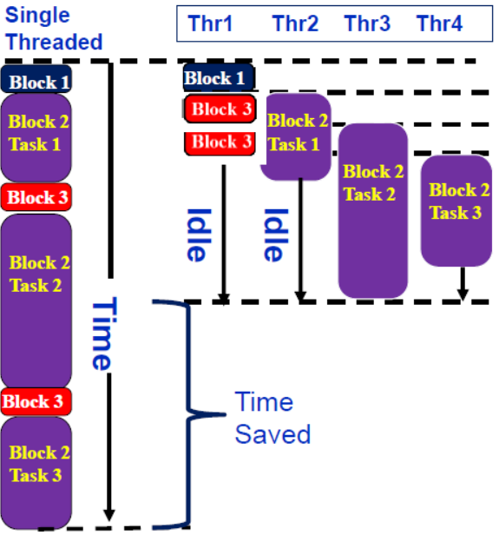
Execution of tasks
Have potential to parallelize irregular patterns and recursive function calls
#pragma omp parallel
{
  #pragma omp single
  { //block 1
    node * p = head;
    while (p) { // block 2
    #pragma omp task
    process(p);
    p = p->next; //block 3
    }
  }
}

Slide 8
When tasks completed?
Tasks are guaranteed to be complete at thread barriers:
  #pragma omp barrier
or task barriers
  #pragma omp taskwait
Multiple foo tasks created
here – one for each thread
#pragma omp parallel
{
  #pragma omp task
  foo();
  #pragma omp barrier
  #pragma omp single
  {
  #pragma omp task
  bar();
  }
}
All foo tasks guaranteed to
be completed here
One bar task created here
bar task guaranteed to be
completed here

Slide 9
Data Scoping with tasks
Fibonacci example:
  The divide and conquer design pattern
n is private in both tasks
int fib ( int n )
{
  int x,y;
  if ( n < 2 ) return n;
  #pragma omp task
  x = fib(n-1);
  #pragma omp task
  y = fib(n-2);
  #pragma omp taskwait
  return x+y
}
x is a private variable
y is a private variable
What’s wrong here?
A task’s private variables are undefined outside the task

Slide 10
Data Scoping with tasks
Fibonacci example:
  The divide and conquer design pattern
n is private in both tasks
int fib ( int n )
{
  int x,y;
  if ( n < 2 ) return n;
  #pragma omp task shared (x)
  x = fib(n-1);
  #pragma omp task shared (y)
  y = fib(n-2);
  #pragma omp taskwait
  return x+y
}
x & y are shared
Good solution
we need both values to compute the sum

Slide 11
Data Scoping with tasks
List Traversal example:
What’s wrong here?
List ml; //my_list
Element *e;
#pragma omp parallel
#pragma omp single
{
  for(e=ml->first;e;e=e->next)
  #pragma omp task
  process(e);
}
Possible data race !
Shared variable e
updated by multiple tasks

Slide 12
Data Scoping with tasks
List Traversal example:
What’s wrong here?
List ml; //my_list
Element *e;
#pragma omp parallel
#pragma omp single
{
  for(e=ml->first;e;e=e->next)
  #pragma omp task firstprivate(e)
  process(e);
}
Good solution
– e is firstprivate

Slide 13
Test2-2: tasks in OpenMP
Consider the program linked.c
  Traverses a linked list computing a sequence of Fibonacci numbers at each node.
Parallelize this program using tasks.
Compare your solution’s complexity to an approach without tasks.
Code:
  test2_Fibonacci/solutions/linked_omp3_tasks.c

Slide 14
Working with OpenMP
Tasks
Monte Carlo Calculations
The scary stuff
  Memory model
  Atomics
  Flush
  Pairwise Synchronization

Slide 15
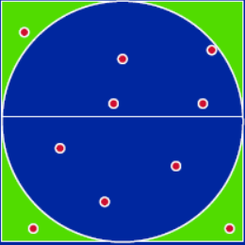
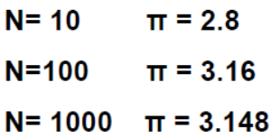
Monte Carlo Calculations
Monte Carlo Method:
  Using Random numbers to solve tough problems
  Sample a problem domain to estimate areas, compute probabilities, find optimal values, etc.
Example: Computing π with a digital dart board:

Slide 16
Monte Carlo Calculations:
Throw darts at the circle/square.
Chance of falling in circle is proportional to ratio of areas:
  Ac = r2 * π
  As = (2*r) * (2*r) = 4 * r2
  P = Ac/As = π /4
Compute π by randomly choosing points, count the fraction that falls in the circle, compute pi.
Code: test3_Pi_mc/pi_mc.c

Slide 17
Monte Carlo Calculations:
Parallel Programmers love Monte Carlo algorithms.
Embarrassingly parallel:
  the parallelism is so easy its embarrassing.
Add two lines and you have a parallel program.
Code: test3_Pi_mc/solutions/pi_mc_par.c

Slide 18
Linear Congruential Generator (LCG)
LCG: Easy to write, cheap to compute, portable, OK quality.
If you pick the multiplier and addend correctly, LCG has a period of PMOD.
Picking good LCG parameters is complicated, so look it up (Numerical Recipes is a good source):
  􀂋 MULTIPLIER = 1366
  􀂋 ADDEND = 150889
  􀂋 PMOD = 714025

Slide 19
PI_MC with LCG generator
Problem：
  Run the same program the same way and get different answers!
  That is not acceptable!
Issue:
  the LCG generator is not threadsafe
Code:
  test3_Pi_mc/solutions/random_seq_lcg.c

Slide 20
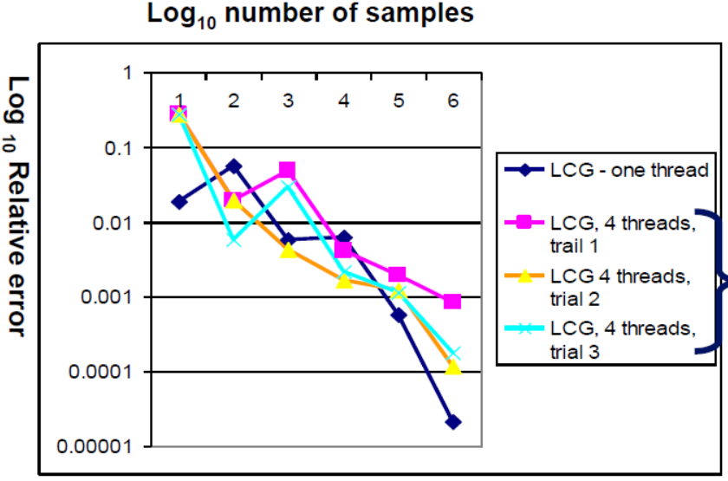
PI_MC with LCG generator

Slide 21
LCG code: threadsafe version
#pragma omp threadprivate(random_last)
random_last carries state between random number computations
To make the generator threadsafe, make random_last threadprivate so each thread has its own copy.
Code:
  test3_Pi_mc/solutions/random_par.c

Slide 22
Data sharing: Threadprivate
Makes global data private to a thread
  C: File scope and static variables, static class members
Different from making them PRIVATE
  with PRIVATE global variables are masked.
  THREADPRIVATE preserves global scope within each Thread
Threadprivate variables can be initialized using COPYIN or at time of definition (using languagedefined initialization capabilities).

Slide 23
A threadprivate example (C)
Use threadprivate to create a counter for each thread.
int counter = 0;
#pragma omp threadprivate(counter)
int increment_counter()
{
  counter++;
  return (counter);
}

Slide 24
Thread safe random number generators
Thread safe version gives the same answer each time you run the program.
But for large number of samples, its quality is lower than the one thread result!
Why?

Slide 25
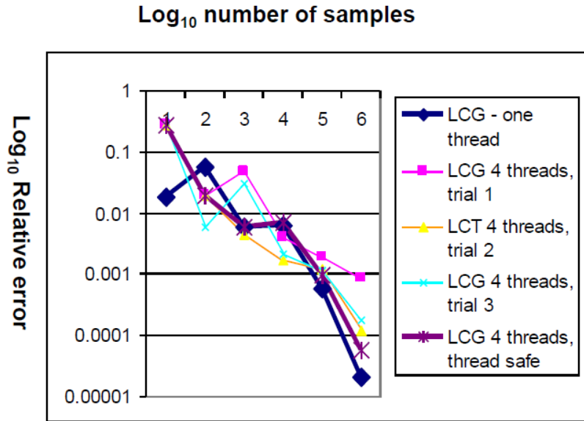
Thread safe random number generators
Thread safe version gives the same answer each time you run the program.
But for large number of samples, its quality is lower than the one thread result!
Why?

Slide 26
Pseudo Random Sequences
Random number Generators (RNGs) define a sequence of pseudo-random numbers of length equal to the period of the RNG
In a typical problem, you grab a subsequence of the RNG range
Grab arbitrary seeds and you may generate overlapping sequences
Overlapping sequences = over-sampling and bad statistics … lower quality or even wrong answers!

Slide 27
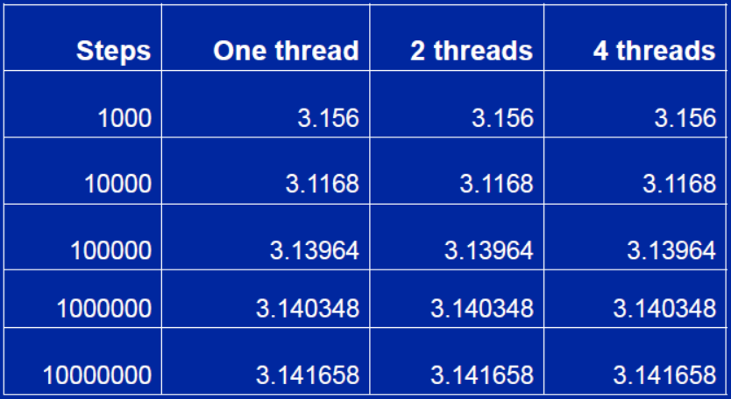
Same sequence with many threads
We can use the leapfrog method to generate the same answer for any number of threads

Slide 28
Parallel random number generators
Multiple threads cooperate to generate and use random numbers.
Solutions:
  Replicate and Pray
  Give each thread a separate, independent generator
  Have one thread generate all the numbers.
  Leapfrog … deal out sequence values “round robin” as if dealing a deck of cards.
  Block method … pick your seed so each threads gets a distinct contiguous block.
OR… use/buy a math library that does it right.

Slide 29
Working with OpenMP
Tasks
Monte Carlo Calculations
The scary stuff
  Memory model
  Atomics
  Flush
  Pairwise Synchronization

Slide 30
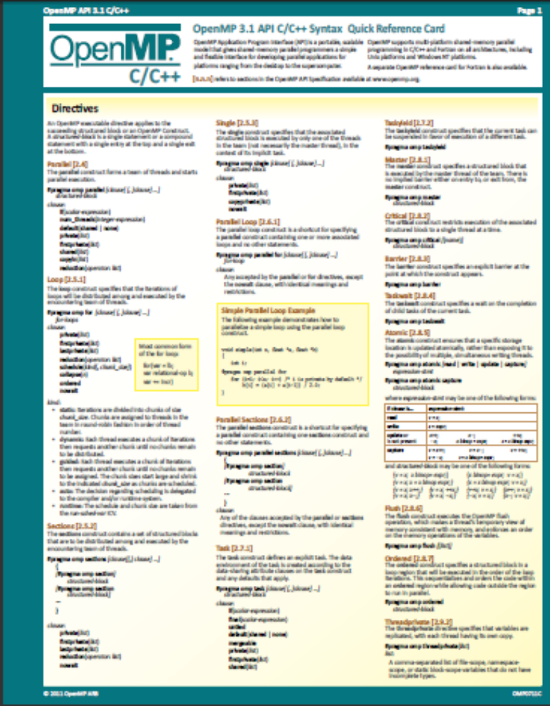
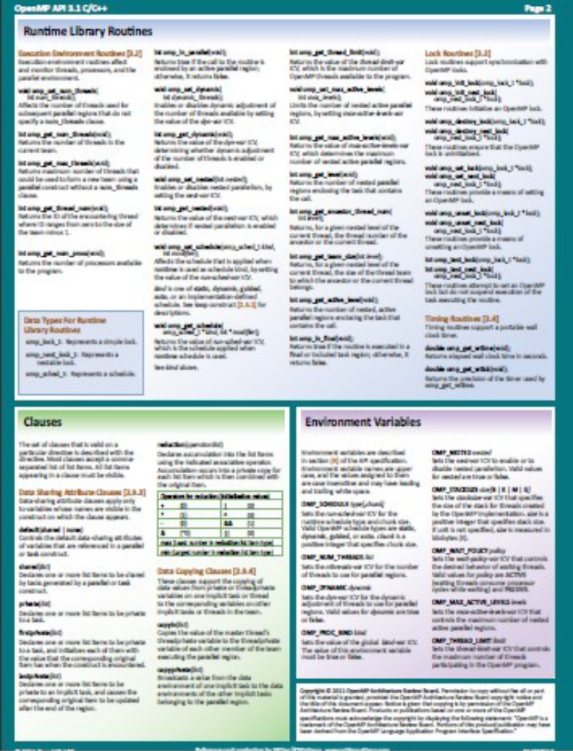
http://openmp.org/mp-documents/OpenMP3.1-CCard.pdf

Slide 31
references
Tim Mattson, A “Hands-on” Introduction to OpenMP, Intel Corp.
Mark Bull, Parallel Programming with OpenMP, EPCC, University of Edinburgh, UK.
迟学斌等，并行计算与实现技术，科学出版社。

